Slide 1
Cost-Efficient Embedding of
Virtual Networks
With and Without
Routing Flexibility
IFIP Networking 2020
Balázs Németh, Budapest Univ. of Technology and Economics, Hungary
Yvonne-Anne Pignolet, DFINITY, Switzerland
Matthias Rost, TU Berlin, Germany
Stefan Schmid, Faculty of Computer Science, University of Vienna, Austria
Balázs Vass, Budapest Univ. of Technology and Economics, Hungary

Slide 2
Introduction: Virtual Network Embeddings

Slide 3
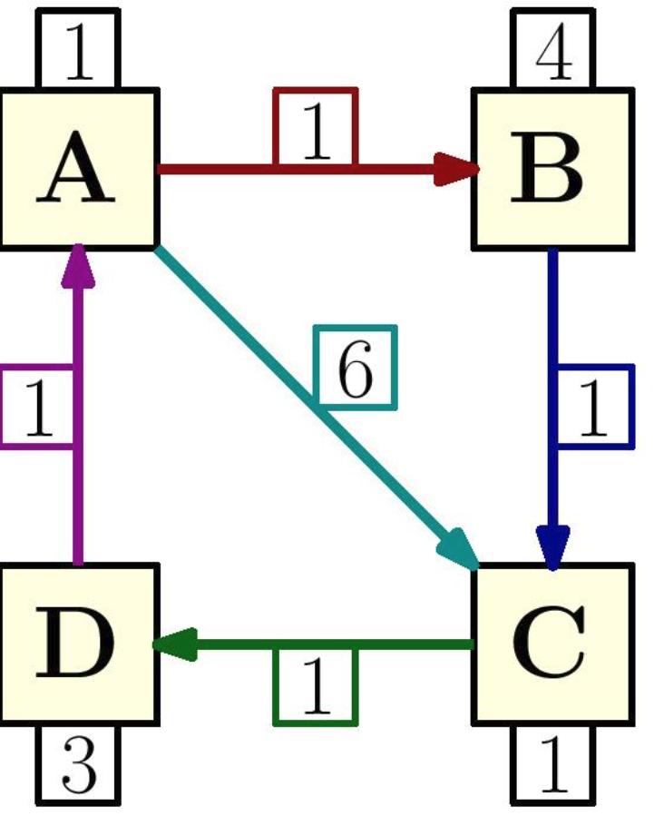

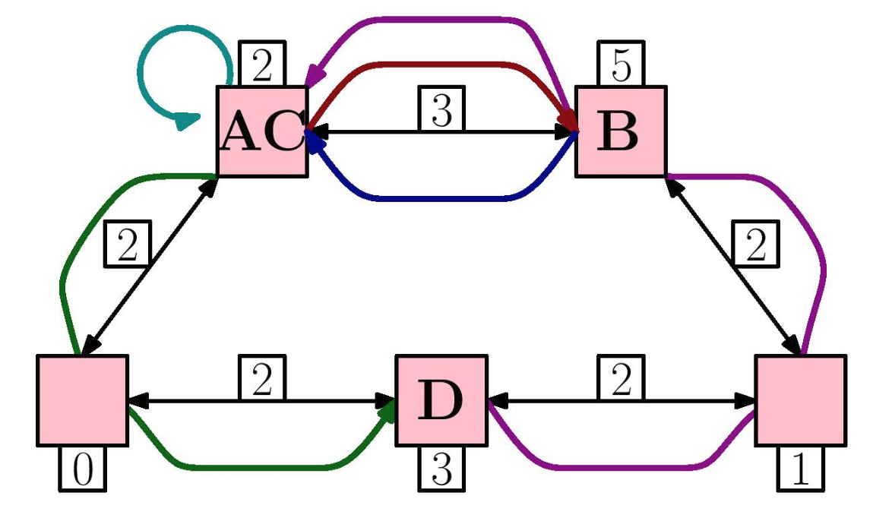
Request and Substrate Graphs
Request: directed weighted graph G_{r}=(V_{r}, E_{r}, d_{r})
V_{r} : request (virtual) nodes
E_{r}⊆V_{r}×V_{r} : request (virtual) edges directed data flow between request nodes.
Element x ∈V_{r}∪E_{r} has demand d_{r}(x)≥0 e.g., CPU, memory, bandwidth requirements
For request graph r ∈ R , n_{r}=|V_{r}| and m_{r}=|E_{r}|
Substrate: weighted graph G_{S} = (V_{S}, E_{S}, d_{S})
V_{S} : physical machines
E_{S} : physical communication links
Element x ∈ V_{S} ∪E_{S} has capacity d_{S}(x)≥0 e.g., CPU, memory, bandwidth, etc.)
n_{s}=|V_{s}| and m_{s}=|E_{s}|

Slide 4
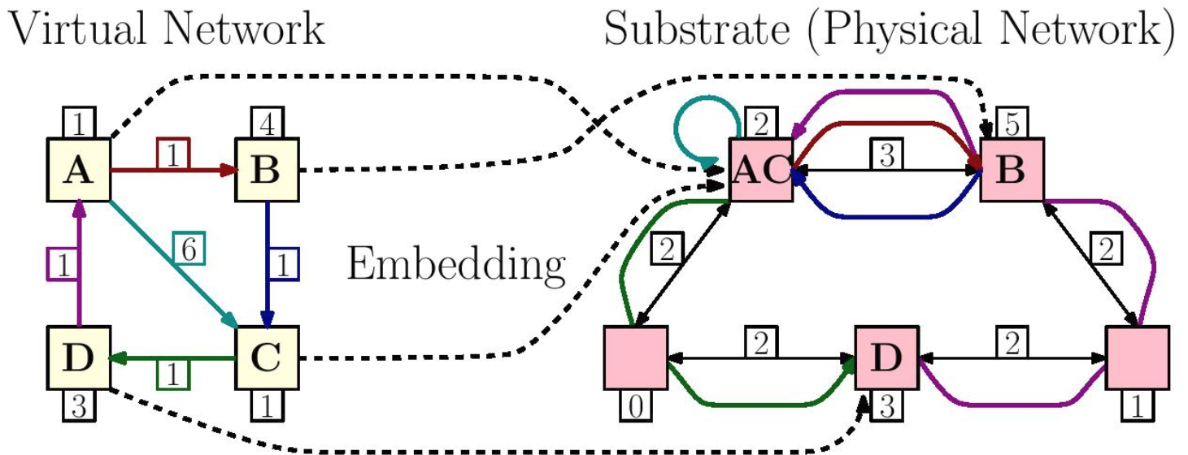

Embedding of Virtual Networks
Given a set of requests R, we want to:
Map virtual element to substrate element, s.t. the mapping is valid + feasible,
valid: respects restrictions (e.g., avoids distant substrate nodes, or substrate links raising security issues)
feasible: valid + respects substrate capacities
Cost of mapping a request r:
A(m_{r},x) : resource allocation induced by valid mapping m_{r} on substrate element x ∈ G_{S}
c_{S}(x) : unit cost of substrate resource x∈G_{S}
Cost of a mapping m_{r} of r is defined as:

Slide 5
Problem Versions
Cost Valid Mapping Problem (CVMP): return valid minimal cost mapping m_{r}or request r on substrate s, if one exists f
Cost Virtual Network Embedding Problem (CVNEP): return minimal cost feasible embedding M_{R} for the request set R on substrate s, if one exists.
Profit Virtual Network Embedding Problem (PVNEP): Given a profit b_{r}≥0 for each request r∈R, return feasible embedding of a subset of requests R’⊆R maximizing the profit Σ_{r ∈R} b_{r}.
VNEP without Routing Flexibilities. Given a routing P, a mapping m_{r} is valid if each virtual edge takes the path predefined in P. Under this adaptation, CVNEP and PVNEP return a feasible embedding minimizing the cost or maximizing the profit for a request set R.
(α, β, γ) -approximation of the CVNEP (or PVNEP):
at most α > 1 times the cost (or at least 1/α times the profit) of an optimal solution
allocations on nodes and edges within factors of β ≥ 1 and γ ≥ 1 of the original capacities respectively, with high probability (whp).

Slide 6
Contributions

Slide 7
Main Contributions
polynomial-time approximation for the general Cost VNEP
via randomized rounding
first polynomial-time approximation algorithm with provable guarantees on embedding cost
defining novel variant of VNEP where routes cannot be optimized, (e.g., due to performance considerations or technological constraints)
adapting algorithms and approximation guarantees

Slide 8
Preliminaries

Slide 9
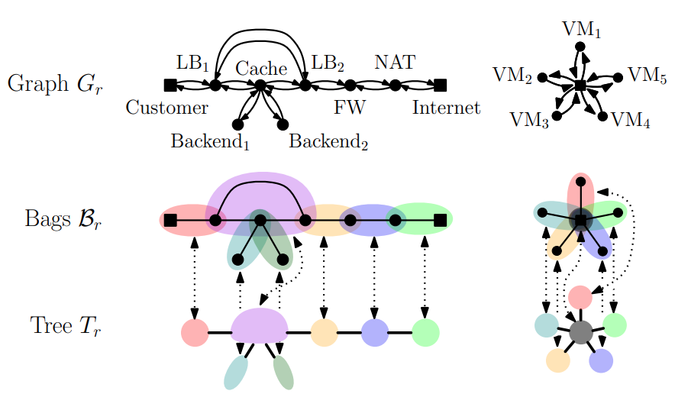
Tree Decompositions
pair T_{r} = (T_{r} ,B_{r}) ,
undirected tree T_{r}=(V_{T},E_{T}) and a family of node bags B_{r}={B_{t}} t ∈V_{T} with B_{t}⊆V_{r}, s.t.:
for node i ∈ V_{r}, set of tree nodes containing i is connected in T_{r},
each node and each edge is contained in at least one bag.
small if no two adjacent bags B₁ and B₂ s.t. B₁ ⊆ B₂
treewidth: max. bag size minus 1
treewidth tw(G_{r}): minimum widths among all decompositions
Computing a tree decomp. of minimal width is FPT-tractable
...and can be transformed into a small decomp. in linear time
In practice, request graphs are of low tree-width.

Slide 10
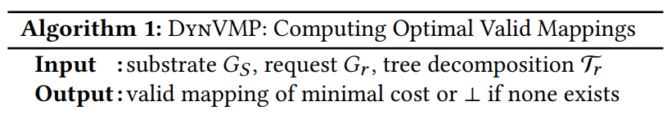

Solving the Cost Valid Mapping Problem
Given a tree decomposition T_{r} of request graph r, algorithm DynVMP solves the CVMP optimally in
for details, see [6]: M. Rost, E. Döhne, and S. Schmid, “Parametrized complexity of virtual network embeddings: Dynamic & linear programming approximations,”in ACM SIGCOMM Computer Communication Review. ACM, 2019.

Slide 11
Polynomial Time Constant Approximation for Cost VNEP

Slide 12
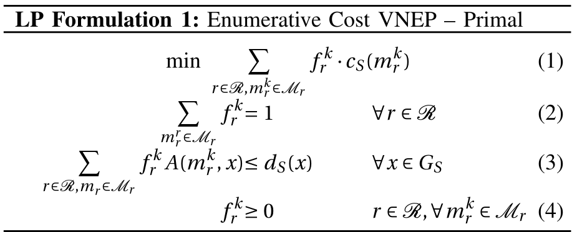
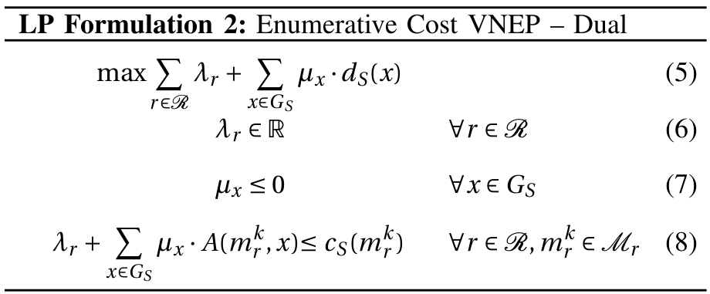
LP Relaxation of Cost VNEP
minimize sum of costs of fractional embeddings
enforce each request to be fully embedded
respect capacities
Analogously for Profit VNEP

Slide 13
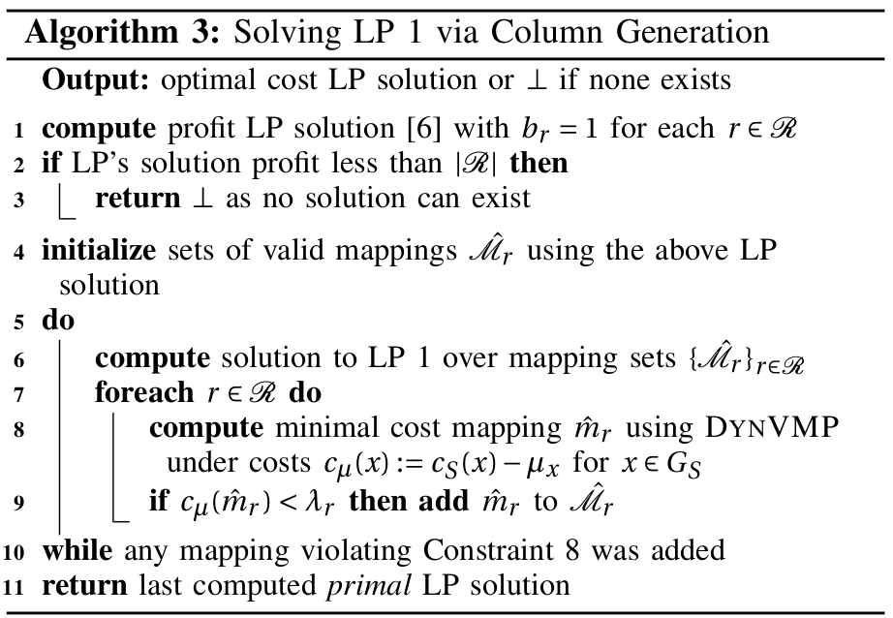

Solve LP Relaxation of CVNEP
Theorem 1: Alg. 3 solves LP 1 optimally in

Slide 14
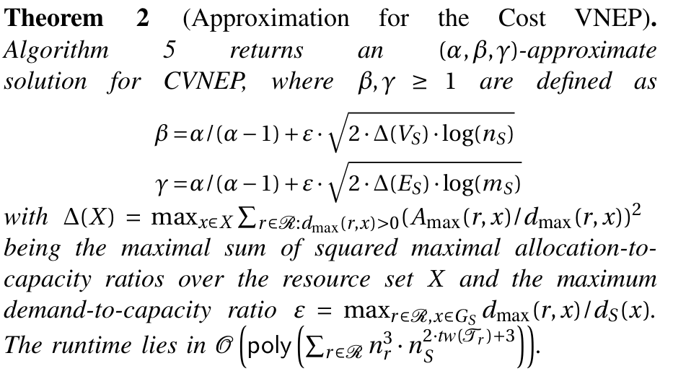
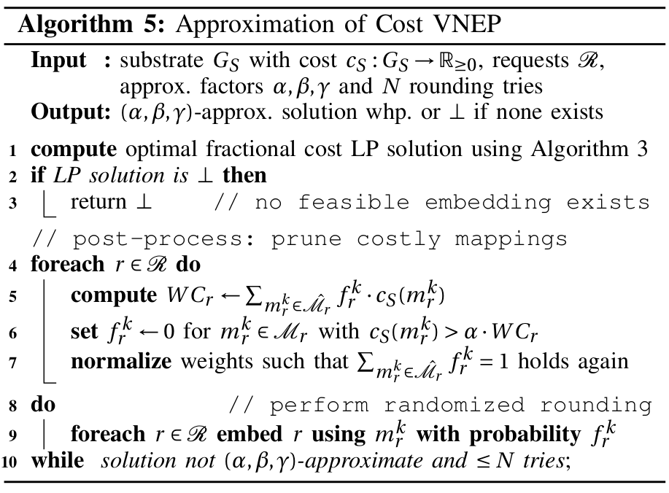
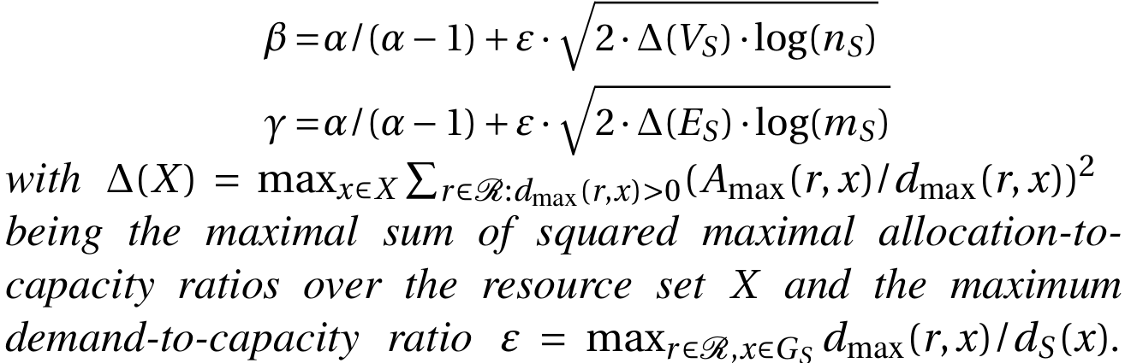
Approximation of (the Integer) CVNEP
Theorem 2: Algorithm 5 (α, β, γ)-approximates CVNEP.
Approximation ratios β, γ (for node and edge capacity exceedance, resp.) are:
Runtime in
differs from profit version by pruning costly mappings

Slide 15
Evaluation

Slide 16
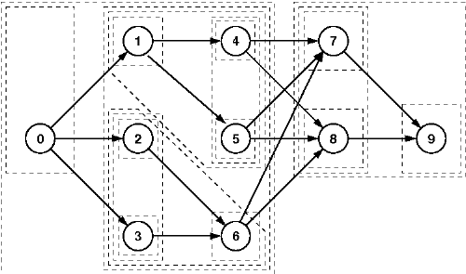
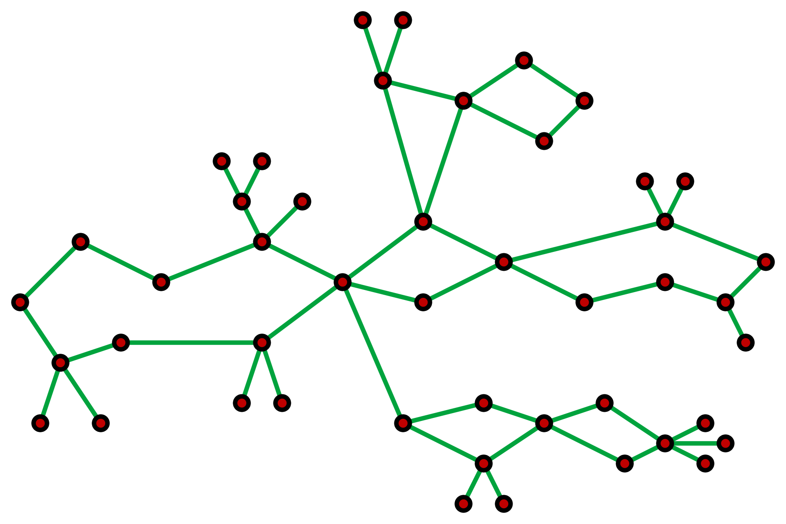
Synthetic Experiments
Substrate: cactus graphs (model industrial communication networks)
Request: series-parallel graphs (model control loops, map-reduce apps, etc.)
cactus
series-parallel
J. Keller et. al. PEELSCHED: a Simple and Parallel Scheduling Algorithm for Static Taskgraphs, PARS: Parallel-Algorithmen, -Rechnerstrukturen und -Systemsoftware: Vol. 28, No. 1. Gesellschaft für Informatik e.V.. (S. 100-109). DOI: 10.1007/BF03341989
Both graphs are randomly generated with 2x more nodes in request graphs than in substrate
https://en.wikipedia.org/wiki/Cactus_graph
cactus https://www.graphclasses.org/classes/gc_108.html
series-parallel: https://www.graphclasses.org/classes/gc_275.html

Slide 17
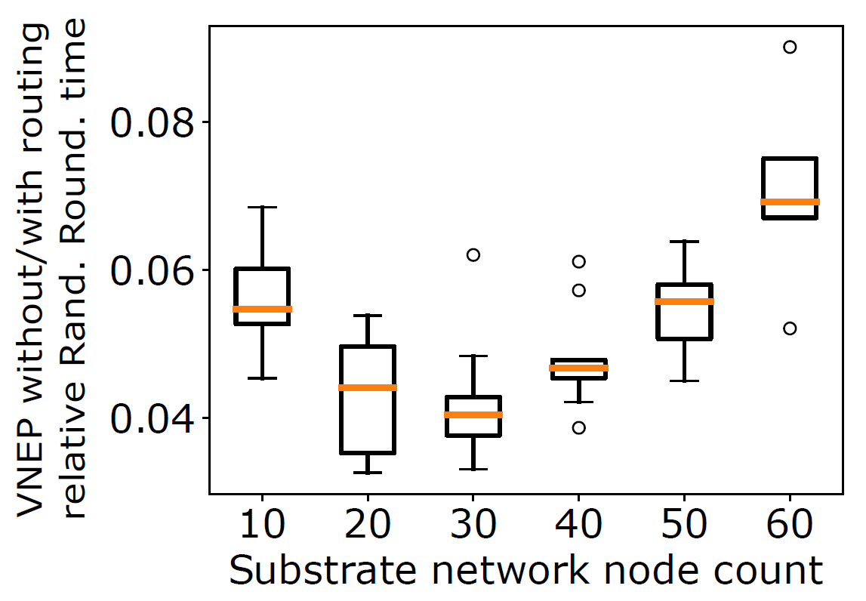
Synthetic Experiment Results (1/2)
Relative rounding time of running without routing constraints to with routing constraints.
Only 4-8% of time required for rounding solutions without
Reason: with routing constraints more valid embeddings are generated (Algoritm 3 runs longer)

Slide 18
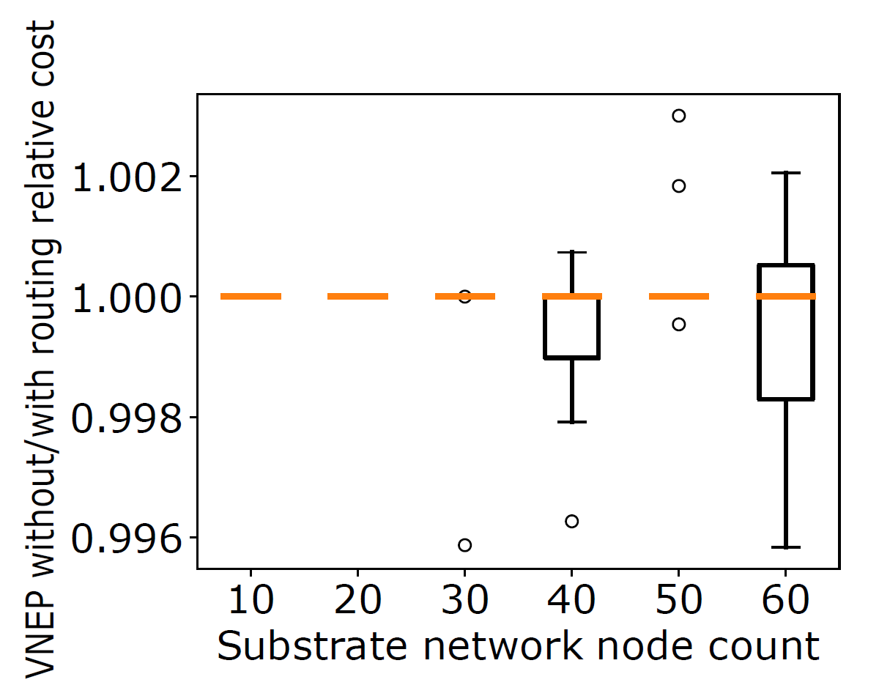
Synthetic Experiment Results (2/2)
Relative integer cost between the two variants
Cost are not really influenced by the problem variant
Shortest path routing is a good edge embedding

Slide 19
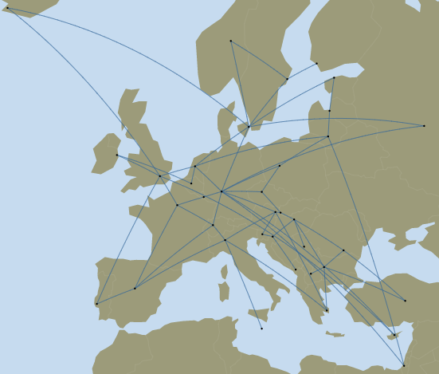
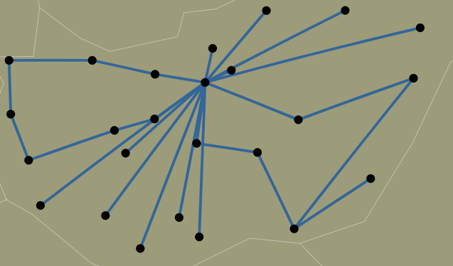
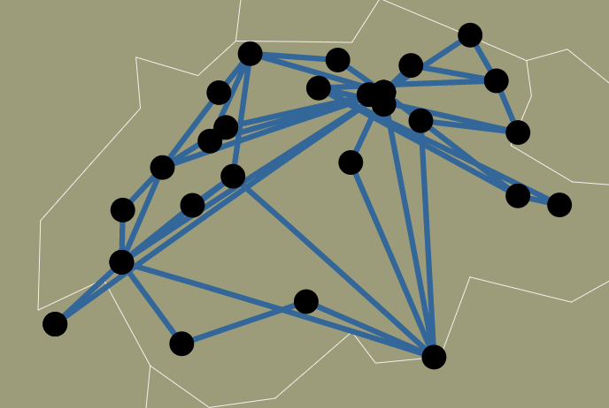
Topology Zoo Substrates
GtsHungary (30 nodes)
series-parallel request graphs as for purely synthetic evaluation
Geant2012 (40 nodes)
SwitchL3 (42 nodes)

Slide 20
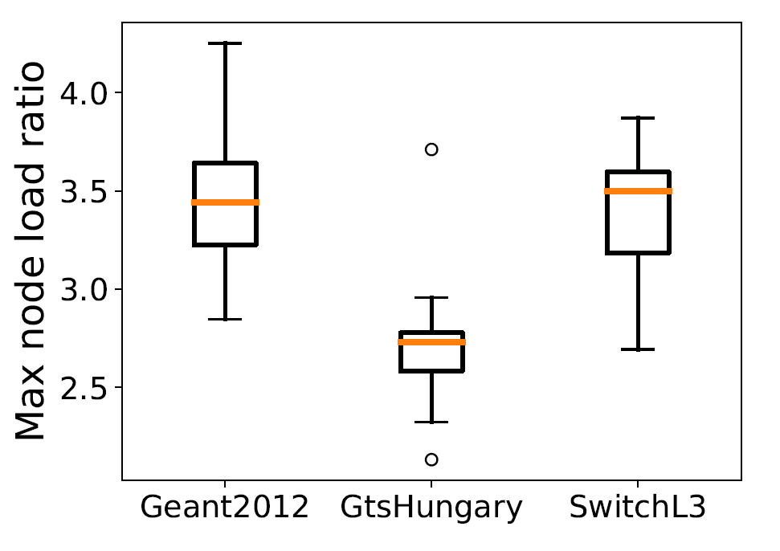
Topology Zoo Results
Max node load : node capacity violation (violation bound is 5.0)
Networks with mores nodes have higher max violation on average
Reason: DynVMP tends to collocate nodes, rounding can only work from those generated mappings

Slide 21
Conclusion
Virtual Network Embedding Problem (VNEP) is fundamental and intensively studied
First constant approximation for cost VNEP
Consider VNEP with fixed routing paths
Simulation results on synthetic and real-world topologies show applicability

